Slide 1


Introduction to Angular Development
Women Who Code + TD Bank

Slide 2
Welcome!
GET CONNECTED | Wifi: wifi network Password: wifi password
DOWNLOAD & INSTALL

Slide 3
Prerequisites
Install Node.js and NPM
Visit the downloads section of Nodejs.org and download/run the appropriate installer based on your OS. Follow through the installation steps with default settings, which will install NPM by default.
To check whether you have both of these installed, go to command line or console and type:
$ node -v
$ npm –v
Install Angular CLI globally
The Angular CLI (Command Line Interface) is the quickest and easiest way to get started with a brand new Angular 5 project.
We're going to use NPM to install the Angular CLI through the following command:
$ npm install @angular/cli –g
Once installed, you can access the CLI tool by typing ng. To check the version of your Angular CLI, type:
$ ng –v
It should return a response like this:
_ _ ____ _ ___
/ \ _ __ __ _ _ _| | __ _ _ __ / ___| | |_ _|
/ △ \ | '_ \ / _` | | | | |/ _` | '__| | | | | | |
/ ___ \| | | | (_| | |_| | | (_| | | | |___| |___ | |
/_/ \_\_| |_|\__, |\__,_|_|\__,_|_| \____|_____|___|
|___/
Angular CLI: 1.7.4
Node: 8.9.4
OS: darwin x64
Angular:
...
WIFI DETAILS
Network Name: TDBank
Password: tdgreen

Slide 4

Schedule
6:00PM - 6:30PM: Sign-In and Troubleshooting Environment Setup
6:30PM - 7:00PM: Presentation
7:00PM – 8:30PM: Tutorial & Project
8:30PM - 9:30PM: Q&A and Networking
Notes:
Introductions: Light food and WIFI details

Slide 5




Who are we?
Mengfei Wang
Yubing Liu
Angela Choo
Front End Developer
WebBroker
Full Stack Developer
Payments Innovation
Front End Developer
Wealth Technology
Jet Yue
Marie Gavin
Full Stack Developer
Online Banking
Developer
WebBroker
Notes:
Introduce team.
Before we begin, I want to learn more about everyone here.
Lets get a show of hands, who in the audience knows
HTML
JavaScript
TypeScript
AngularJS
Angular
ReactJS
- Some other JavaScript framework

Slide 6
Agenda
What is Angular?
Why Angular?
The State of JavaScript
Conceptual Overview
The Main Building Blocks of an Angular Application
Make Demo Application!
Notes:
The Agenda for today. We'll first cover …

Slide 7
What is Angular?
Angular is a Javascript framework for building client-side applications across the web, desktop, and even native mobile apps.
Version 2 and above
Version 1.x
Notes:
Angular is a JavaScript framework for building applications across the web, desktop, and even native mobile apps.
One question that often comes up is what’s the difference between AngularJS, Angular 2, Angular 4, and Angular 5?
So there are two kinds of Angular
AngularJS (1.x) which is the first generation of Angular, written in JavaScript
Angular which refers to Angular 2 or later
In today’s session, we’re focusing on Angular, version 5

Slide 8

Why Angular?
Expressive HTML
Powerful Data Binding
Modular By Design
Built-in Back-End Integration
Notes:
Why Angular?
Why Angular and not some other JavaScript framework? And there are a lot of Javascript frameworks out there.
Expressive HTML: Angular makes our HTML more expressive. It powers up our HTML with features such as if conditions, for loops, and local variables.
Powerful Data Binding: Angular has powerful data binding. We can easily display fields from our data model, track changes, and process updates from the user.
Modular By Design: Angular promotes modularity by design. Our application becomes a set of building blocks, making it easier to create and reuse content.
Built-in Back-End Integration: Angular has built-in support for communication with a backend service. This makes it easy for our applications to integrate with a back-end service, to get and post data or execute server-side business logic.
No wonder Angular is so popular with millions of web developers.

Slide 9
Why a new Angular?
Built For Speed
Modern
Simplified API
Enhances Productivity
Notes:
Why a New Angular?
With so many developers already using AngularJS, why did we need a new Angular?
Built For Speed: Angular is built for speed. It has faster initial loads, faster change detections, and improved rendering times.
Modern: Angular is modern. It takes advantages of features provided in the latest JavaScript standards and beyond such as classes, modules, and decorators, yet it supports both Greenfield and Legacy browsers.
Simplified API: Angular has a simplified API, it has fewer built-in directives to learn, simpler bindings, and a lower overall concept count.
Enhances Productivity: Angular enhances our productivity to improve our day-to-day workflow. You'll see these productivity improvements as we go through this course and we'll discern a consistency of patterns for building the blocks that form an Angular application.

Slide 10
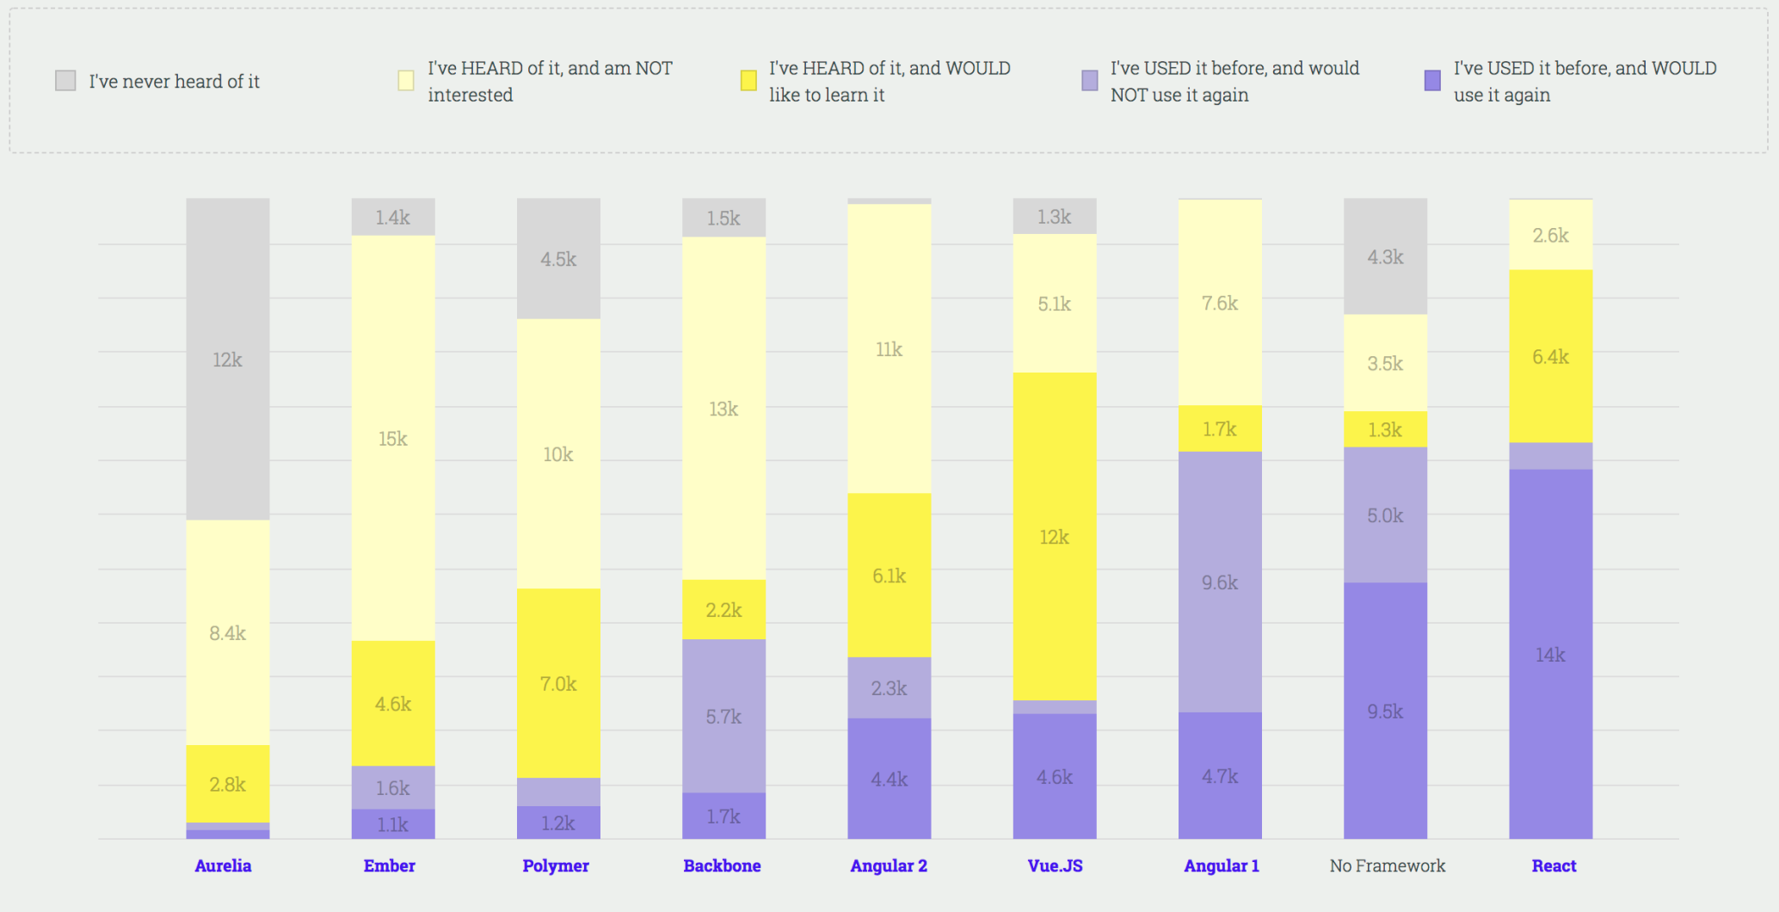
The State of JavaScript Report
Source: https://stateofjs.com/
Notes:
https://insights.stackoverflow.com/survey/2017#technology
https://stateofjs.com/2017/front-end/results/
‘The State of JavaScript’ report is a collection of data from over 20K developers.
There isn't a framework that works for everyone. The State of JavaScript report allows us to see what's popular in the front-end world.

Slide 11

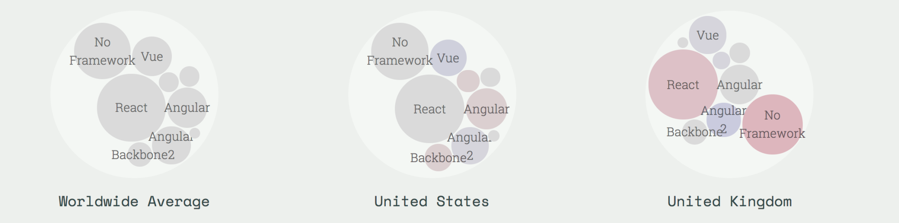
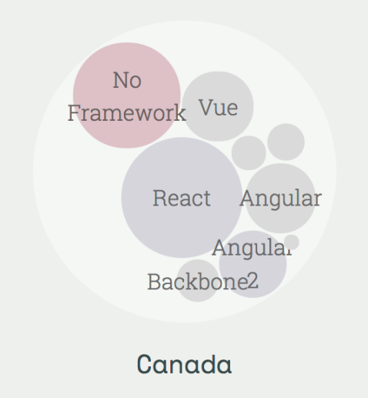
The State of JavaScript – cont.
Notes:
Library usage by country (defined as respondents who picked “have used before and would use again”). Red indicates higher compared to worldwide average, blue indicates lower usage compared to worldwide average.
React seems to dominate the market but Angular and AngularJS do take up a lot of the market share as one of the more popular front-end frameworks used in Canada.
https://www.madewithangular.com/

Slide 12
Made with Angular
Source: https://www.madewithangular.com/

Slide 13
Conceptual Overview
Notes:
https://angular.io/guide/architecture
Lets start with the conceptual overview of an Angular application.
Together, a component and template define an Angular view.
A decorator on a component class adds the metadata, including a pointer to the associated template.
Directives and binding markup in a component's template modify views based on program data and logic.
The dependency injector provides services to a component, such as the router service that lets you define navigation among views.
We will cover this more in detail.

Slide 14
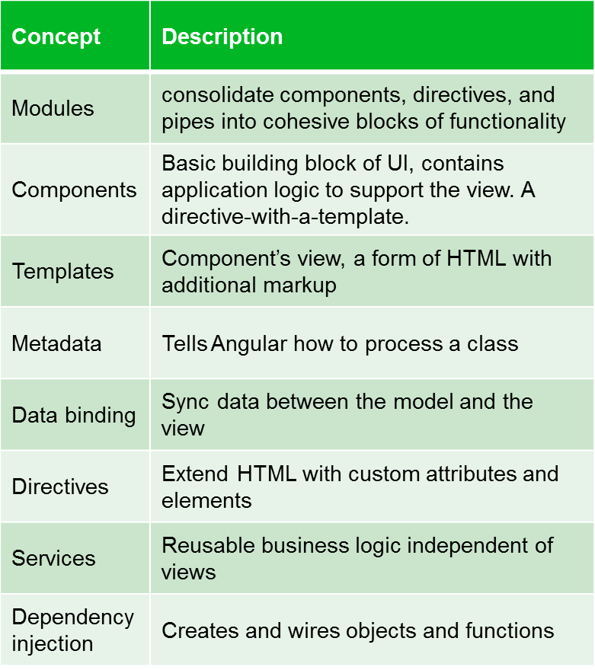
The Main Building Blocks
Notes:
Modules
Angular modules help organize an application into cohesive blocks of functionality.
Components
We can think of our Angular application as a set of components. We create each component, then arrange them to form our application. If all goes well, those components work together in harmony to provide the user with a great experience.
Templates
A template combines HTML with Angular markup that can modify the HTML elements before they are displayed.
Metadata
Metadata is used to decorate a class so that it can configure the expected behavior of the class.
Data Binding
Data binding connects the application data and the document object model(DOM)
Angular supports two-way data binding, meaning that changes in the DOM, such as user choices, can also be reflected back into your program data.
Directives
???
Services
Service is a broad category encompassing any value, function, or feature that an app needs. A service is typically a class with a narrow, well-defined purpose. It should do something specific and do it well.
Dependency Injection
The dependency injector provides services to a component, such as the router service that lets you define navigation among views.
Components consume services; that is, you can inject a service into a component, giving the component access to that service class.

Slide 15
What are Angular Modules?
Code files that organize the application into cohesive blocks of functionality
Organize our application
Modularize our application
Promotes application boundaries
Notes:
Angular modules are …
-----
Angular modules help organize an application into cohesive blocks of functionality. Every Angular application has at least one Angular module by convention called @module. As an application gets more features we can group those features into their own feature modules. We can even define shared or common modules for code used by multiple Angular modules. This keeps the code organized and provides a cohesive unit we can load on start or lazy load as it is needed. In each Angular module we declare the set of components and other code files associated with the module and the dependencies needed by those components. Each component we create is declared in and belongs to one and only one Angular module.

Slide 16
What are Components?
Angular components are the basic building blocks of your app. Each component defines:
Any necessary imports needed by the component
A component decorator, which includes properties that allow you to define the template, CSS styling, animations, etc..
A class, which is where your component logic is stored.
Angular components reside within the /src/app folder:
> src
> app
app.component.ts
App.component.html
App.component.scss

Slide 17
The Basic Component File
import { Component } from '@angular/core';
@Component({ selector: 'app-root', templateUrl: './app.component.html', styleUrls: ['./app.component.scss'] })
export class AppComponent { title = 'app'; }
app.components.ts
Notes:
Want to see what a component looks like in TypeScript? Here is a simple component. It might look complex at first so let's break this component into chunks, starting at the bottom.
Here is our class. It defines the properties and methods needed by our view.
Here is the component decorator that defines the metadata. The metadata includes the template that lays out the view managed by this component.
And here we import the members that we need.
Let's examine each of these chunks in more detail, starting at the bottom with the class.
---
Let's open up the /src/app/app.component.ts component file that the CLI generated for us:
As mentioned previously, at the top we have our imports, the component decorator in the middle (which defines the selector, template and style location), and the component class.
Notice the selector app-root? If you open up /src/index.html you will see a custom HTML tag noted as <app-root></app-root>.
This is where that particular component will load! If you have ng serve running in the console from the previous lesson, you will note that in the browser at http://localhost:4200, the HTML matches the /src/app/app.component.html file.

Slide 18
Component
Components are just ES6 Classes
Providers/Services are injected in the constructor
Need to explicitly define providers and directives within component decoration
Properties and methods of the component class are available to the template

Slide 19
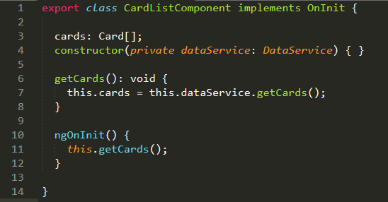
Component
Notes:
Want to see what a component looks like in TypeScript? Here is a simple component. It might look complex at first so let's break this component into chunks, starting at the bottom.
Here is our class. It defines the properties and methods needed by our view. Here is the component decorator that defines the metadata. The metadata includes the template that lays out the view managed by this component. And here we import the members that we need. Let's examine each of these chunks in more detail, starting at the bottom with the class.

Slide 20
Templates are the View
Templates are mostly HTML, with a little help from Angular. They tell us how to render the Component.
Notes:
Components contain logic, but we still need something to render the page, that's where templates come in. HTML is great for rending pages. Sometimes we just need to give it a little bit of help to know what data to render in a list or maybe how to handle a click event. Together our HTML with data binding expressions and directives tell Angular how to render the component.

Slide 21
Defining a Template of a Component
Inline Template
template:
`<div>
<h1>{{pageTitle}}</h1>
<div>`
template:
“<h1>{{pageTitle}}</h1>”
template:
‘./card-list.component.html’
Inline Template
Linked Template

Slide 22
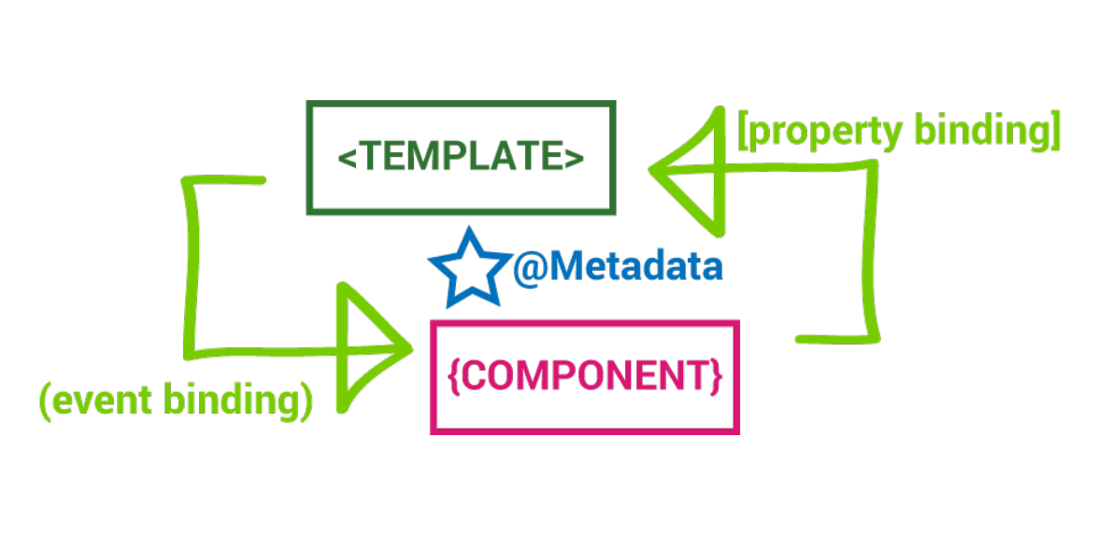
Template
A template is HTML that tells Angular how to render a component
Template include data bindings as well as other component and directives
Angular leverages native DOM events and properties e.g. (click)
Notes:
You define a component's view with its companion template. A template is a form of HTML that tells Angular how to render the component.
Template include data bindings as well as other component and directives
Angular leverages native DOM events and properties e.g. (click)

Slide 23
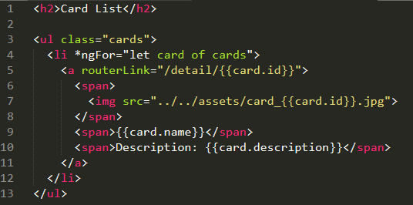
Template
Notes:
By convention, the name of the template is the same name as the component with an HTML extension. We'll call our product list component product-list.component.html.
A template looks like regular HTML, except that it also contains Angular template syntax, which alters the HTML based on your app's logic and the state of app and DOM data. Your template can use data binding to coordinate the app and DOM data, pipes to transform data before it is displayed, and directives to apply app logic to what gets displayed.

Slide 24
Metadata
We use Metadata to tell Angular about the objects we build.
Metadata Links the Template to the Component.
{ }
〈 〉
Metadata
Component
Template
Notes:
There really are three parts that make a component work, there's the component code, then there's also the component template, but there's also the third part, the metadata, the lesser talked about part. It's always there, but we don't pay that much attention to it. The metadata is what goes inside those decorators. We're going to use the metadata to tell things to Angular about how to find the component's template, so that's one thing we use it for like the template URL. So we might have a template and then we've got a component, and then that metadata is that glue that kind of links those two things together, and it gives Angular information about that component, so it can operate better.

Slide 25
Defining the Metadata
import { Component } from '@angular/core';
@Component({ selector: 'app-root', templateUrl: './app.component.html', styleUrls: ['./app.component.scss'] })
export class AppComponent { title = 'app'; }
app.components.ts
Decorators
The @ is a decorator that provides metadata describing the Component
Component
Component definition class. Controls a patch of screen that we call the view
Notes:
A class becomes an Angular component when we give it component metadata. Angular needs that metadata to understand how to instantiate the component, construct the view, and interact with the component. We define a component's metadata with the Angular component function. In TypeScript we attach that function to the class as a decorator.
A decorator is a function that adds metadata to a class, its members, or its method arguments. A decorator is a JavaScript language feature that is implemented in TypeScript. The scope of the decorator is limited to the feature that it decorates. A decorator is always prefixed with an @ sign.
----
Here are using templateUrl to define the location of our linked template instead of defining an HTML string. Notice the syntax of the path here. If we follow the convention of defining the template HTML file in this same folder as the associated component we can use a relative path by specifying ./.
----
Here’s an example example of our metadata in a component. We have a decorator, @Component, right at the top, and this decorates our AppComponent, so the at sign is going to be indicating that it's a decorator and it's going to provide metadata that describes the component right here. And the component definition, it's just a class and it's going to be something that controls an area on the screen and we call that the view.
Now there's other things in here too like templates and styles. The templateUrl tells it where to find that HTML in our template syntax and the style URL is plural because it can be an array of different CSS files or SASS or something else you might want to use. And those will all be associated with this component.

Slide 26
Data Binding
We use data binding to help coordinate communication between a Component and its Template.
Interpolation
One Way Binding
Event Binding
{ }
Two Way Binding
DOM
Component
Notes:
One of the most appreciated feature of Angular is data binding.
Let's explore what data binding is and how it works with Angular. First we're got a DOM, that's our browser, and then we've got a component, our code. And we need to get the data to pass from the component to the DOM and sometimes back. So we have different ways to do this. We've got Interpolation, which sends the data one way up to the DOM, we also have One Way Binding, which again sends it one way up, we have Event Binding so we can talk from the DOM with user actions back to the component, maybe like a click event, and then we have Two Way Binding.

Slide 27
TD Credit Card List
We will create a simple app that covers most of the fundamentals of Angular. (Modules, Components, Templates, Data Binding, Services, Dependency Injection, Routing, and Observable Data)

Slide 28
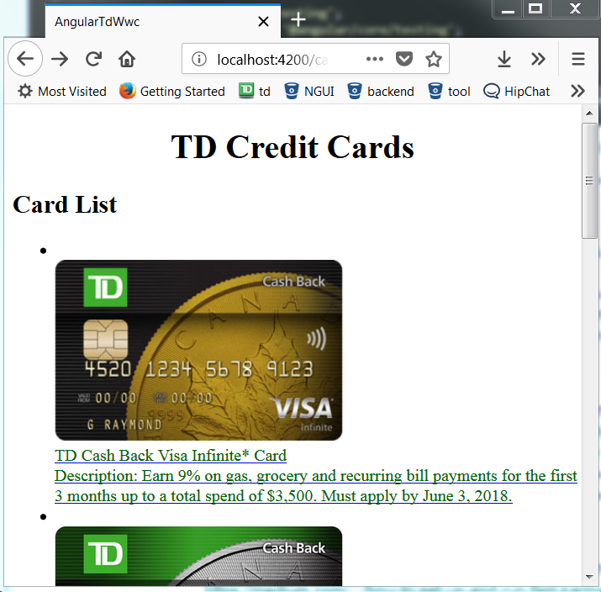
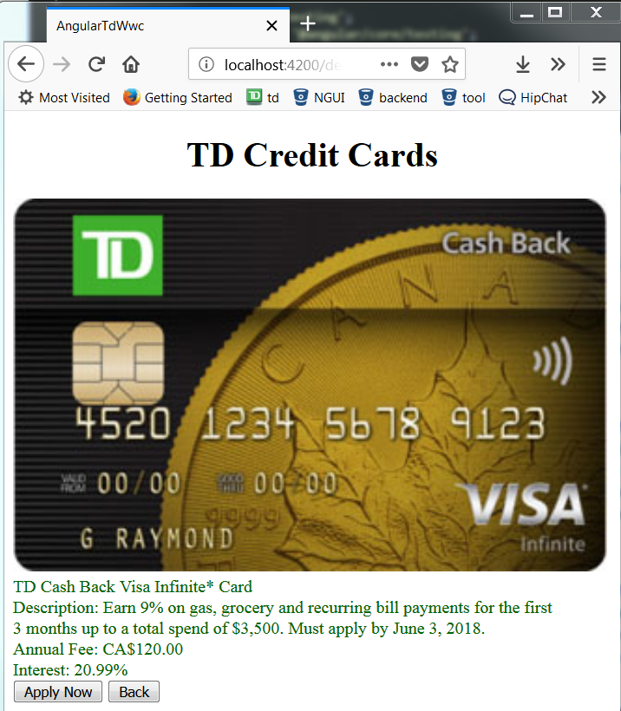
The Credit Cards List App
https://github.com/TDWWC/angular-td-wwc

Slide 29
Create New Application:
cd into directory where you want to contain the new app
Create new application with Angular CLI command: ng new angular-td-wwc
ng new <project-name> generate a new project with default project structures and supporting files

Slide 30
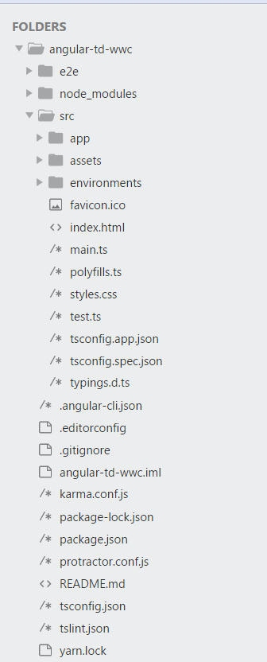
Angular Directory Structure
e2e
Contains end to end tests
node_modules
NPM is the node package manager, which instals packages
locally into this folder
src
Contains the project code, like components, templates, styles
karma.conf.js
unit test configuration file
Protractor.conf.js
end to end test configuration file
package.json
Defines what libraries will be installed into node_modules when you run npm insall

Slide 31
Serve the Application:
Open up a terminal and cd into your project root directory
Server the application with Angular CLI command: ng serve –open
The above command does the following things:
Builds the application
Start the development server
Watches the source files
Rebuilds the application when you make changes
--open flag automatically launches a browser with the default page

Slide 32
Create New Component
Cd into project root directory
Create a new component named card-list using command: ng generate component card-list
This command creates a new folder, src/app/card-list and generates four files within the folder:
card-list.component.ts (define and control the view)
card-list.component.html (define a component's view – template file)
card-list.component.css (component specific style file)
card-list.component.spec.ts (define unit test logics, not covered in this tutorial)

Slide 33
Class
Create the component as ES6 Classes
Properties and methods in our component will be available for binding in Template

Slide 34
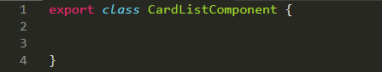
Class

Slide 35
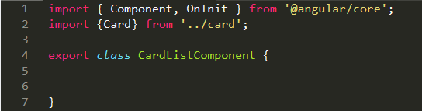
Imports

Slide 36
Decorators
A function that adds metadata to a class, its members (properties, methods) and function arguments.
Common class decorators could be @Component, @Injectable, @Directive etc.
Common member decorators could be @Input, @Output etc.

Slide 37
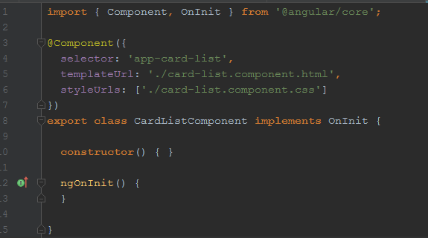
Decorator

Slide 38
Style
Style the card list by copying the following code into card-list.component.css file
https://github.com/TDWWC/angular-td-wwc/blob/master/src/app/card-list/card-list.component.css

Slide 39
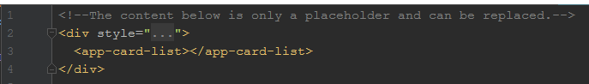
Display Component
To display the card-list component, we need to add it in App Component template file:
Open app.component.html template file
Insert card-list element selector <app-card-list></app-card-list> at the end of the file
View updated content in browser (assume ng serve command is still running)

Slide 40
Create a Card Class
We will create a Card Class that acts as the blueprints for Card instances we will instantiate later on.
Create a new file called "card.ts" in src/app directory
Copy and paste the following code into card.ts
export class Card { id: number; name: string; description: string; annualFee: number; interest: number }
Notes:
Talk about the syntax

Slide 41
Create Mock Data
We will need some Cards to display. In reality, we will get them from a remote data server through HTTP, but for now, we will create some mock data for Cards and pretend they came from the server.
Create a new file called "mock-data.ts" in src/app directory.
Define a CARDS constant as an array and export it
https://github.com/TDWWC/angular-td-wwc/blob/master/src/app/mock-data.ts

Slide 42
Display Card List
Open card-list component and import mock data CARDS
import { CARDS } from '../mock-data'
Add a Cards property in card-list component class which exposes these cards for binding in HTML template
cards = CARDS;

Slide 43
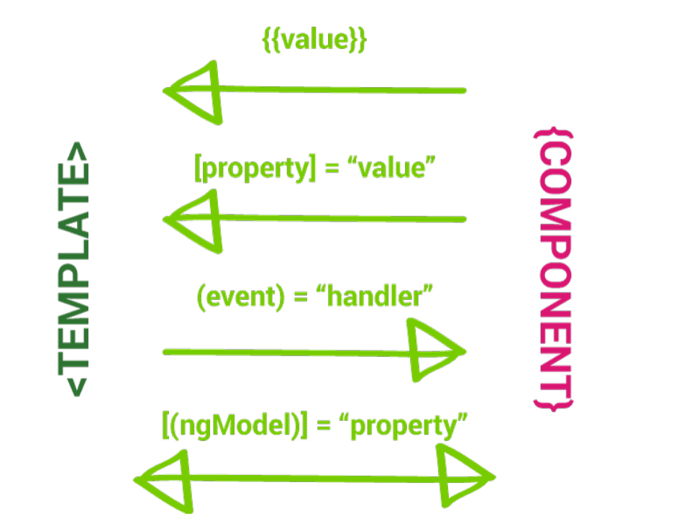
Data Binding

Slide 44
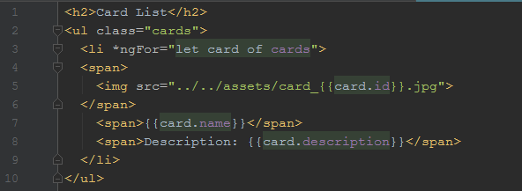
Template
Notes:
List Cards with *ngFor – Angular's repeater directive. It loops through each item with a list. Open card-list.component.html and add the following code

Slide 45
Card details Component
ng generate component card-detail

Slide 46
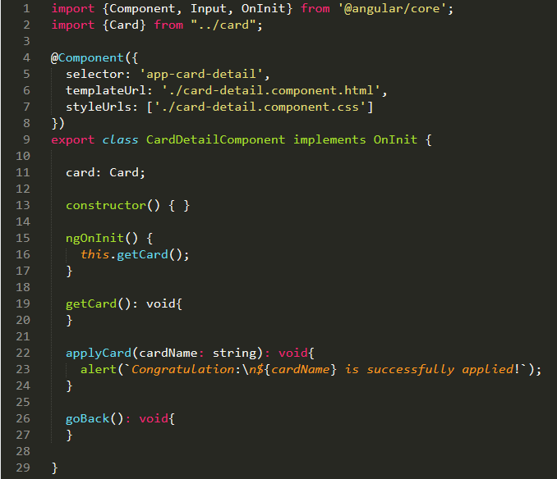
Card Detail Component

Slide 47
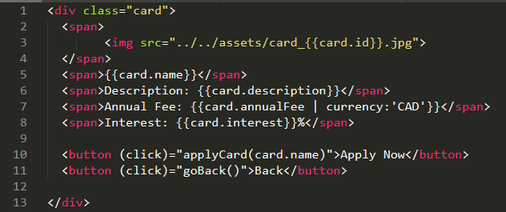
Card Detail template

Slide 48
Services
Components shouldn't fetch or save data directly and they certainly shouldn't knowingly present fake data. They should focus on presenting data and delegate data access to a service.
In this tutorial, you'll create a DataService that all application classes can use to get cards. Instead of creating that service with new, you'll rely on Angular dependency injection to inject it into the CardListComponent and CardDetailComponent constructor.

Slide 49
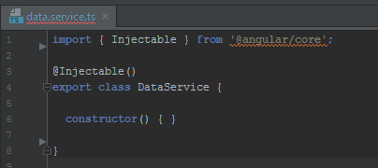
Generating the Service File
Using the Angular CLI, create a service called data: ng generate service data
The command generates skeleton DataService class in /src/app/data.service.ts
@Injectable() services
Notice that the new service imports the Angular Injectable symbol and annotates the class with the @Injectable() decorator.
The @Injectable() decorator tells Angular that this service might itself have injected dependencies. It doesn't have dependencies now but it will soon. Whether it does or it doesn't, it's good practice to keep the decorator.

Slide 50
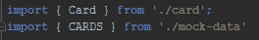
Get Cards data
The DataService could get card data from anywhere—a web service, local storage, or a mock data source.
Removing data access from components means you can change your mind about the implementation anytime, without touching any components. They don't know how the service works.
The implementation in this tutorial will continue to deliver mock cards.
Import the card and CARDS.

Slide 51
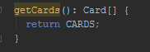
Get Card data – cont.
Add getCards method to return the mock cards.
Save this file.

Slide 52
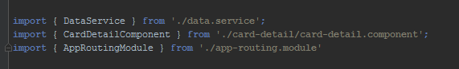

Importing the Service
Each time you generate a service, you need to import and add it to the providers array of the /src/app/app.module.ts file

Slide 53
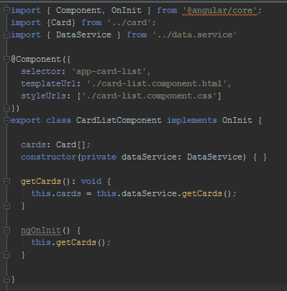
Using the Service in our Components
Open up our /src/app/card-list/card-list.components.ts file and import the service and add it in the constructor via dependency injection:

Slide 54
Using the Service in our Components – cont.
Next, update the methods beneath the constructor
Similarly, do this in /src/app/card-detail/card-detail.components.ts because we want to cards data as well.
Now try it out! You should see the mock cards data in your app.

Slide 55
Routing
We will add a card detail page, so when users click a card in the list, it navigates to a detail view of the selected card.

Slide 56
Routing – Add AppRoutingModule
An Angular best practice is to load and configure the router in a separate, top-level module that is dedicated to routing and imported by the root AppModule.
By convention, the module class name is AppRoutingModule and it belongs in the app-routing.module.ts in the src/app folder.
Use the CLI to generate it
--flat puts the file in src/app instead of its own folder.
--module=app tells the CLI to register it in the imports array of the AppModule.
ng generate module app-routing --flat --module=app

Slide 57
Routing – Add AppRoutingModule
The generated file looks like this:
import { NgModule } from '@angular/core'; import { CommonModule } from '@angular/common; @NgModule({ imports: [ CommonModule ], declaration: [] }) export class AppRoutingModule { }

Slide 58
Routing – Add AppRoutingModule
Generally we don’t declare components in a routing module, so we can delete the @NgModule.declarations array and delete CommonModule reference too.
You’ll configure the router with Routers in the Route-Module, so import those two symbols from the @angular/router library.
Add an @NgModule.exports array with RouterModule in it. Exporting RouterModule makes routerdirectives available for use in the AppModule.
import { NgModule } from '@angular/core'; import { RouterModule, Routes } from '@angular/router'; @NgModule({ imports: [ RouterModule.forRoot(routes) ], exports: [ RouterModule ] }) export class AppRoutingModule { }

Slide 59
Routing – Add Routes
Routes tell the router which view to display when a user clicks a link or pastes a URL into the browser address bar. A typical Route has two properties:
- path: a string that matches the URL.
- component: the component that the router should create when navigating to this route.
Import the CardListComponent, CardDetailComponent so you can reference it in a Route. Then define an array of routes with a single route to that component.
You also need to initialize the router and start it listening for browser location changes. This is done by calling RouterModule.forRoot() in the imports array.

Slide 60
Routing – Add Routes
The finished app-routing.module.ts looks like this:
import { NgModule } from '@angular/core'; import { RouterModule, Routes } from '@angular/router'; import { CardListComponent } from './card-list/card-list.component'; import { CardDetailComponent } from './card-detail/card-detail.component'; const routes: Routes = [ { path: 'cards', component: CardListComponent}, { path: 'detail/:id', component: CardDetailComponent}, { path: '', redirectTo: '/cards', pathMatch: 'full' }, ]; @NgModule({ imports: [ RouterModule.forRoot(routes) ], exports: [ RouterModule ] }) export class AppRoutingModule { }

Slide 61
Routing – Add routerLink to the component
Now, update the card-list.component.html, add the detail link to the individual card row
<ul class="card-list"> <li *ngFor="let card of cards"> <a routerLink="/detail/{{card.id}}"> <div class="card-list-row"> <span class="card-img-col"> <img class="card-list-img" src="../../assets/card_{{card.id}}.jpg"> </span> <span class="card-description-col"> <p class="card-name">{{card.name}}</p> <p class="card-description">{{card.description}}</p> </span> </div> </a> </li> </ul>

Slide 62
Routing – Add routerLink to the component
Update the card-detail.component.html, add a go back button to the bottom of the template, and bind it to the component’s goBack() method.goBack link to the Back button
<div class="card-detail"> <span class="card-detail-row"> <img src="../../assets/card_{{card.id}}.jpg"> </span> <span class="card-detail-row">{{card.name}}</span> <span class="card-detail-row">Description: {{card.description}}</span> <span class="card-detail-row"> <li>Annual Fee: {{card.annualFee | currency:'CAD'}}</li> <li>Interest: {{card.interest}}%</li> </span> <span class="card-detail-row"> <button class="td-button" (click)="applyCard(card.name)">Apply Now</button> <button class="td-button" (click)="goBack()">Back</button> </span> </div>

Slide 63
Routing – Add routerLink to the component
Add a goBack() method to the card-detial.component.ts class that navigates backward one step in the browser’s history stack using the Location service that you injected previously
import {Component, Input, OnInit} from '@angular/core'; import {Card} from "../card"; import {ActivatedRoute} from "@angular/router"; import {Location} from "@angular/common"; import {DataService} from "../data.service"; @Component({ selector: 'app-card-detail', templateUrl: './card-detail.component.html', styleUrls: ['./card-detail.component.css'] }) export class CardDetailComponent implements OnInit {
……
goBack(): void{ this.location.back(); } }

Slide 64
Thank You !
Women Who Code + TD Bank

